Slide 1
Art smart
African Masks
6th grade | January

Slide 2
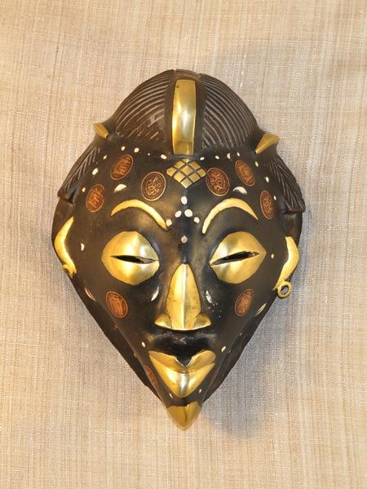
African masks
Function of masks
Patterns of masks
Styles
Materials

Slide 3
Function + Pattern

Slide 4
STYLES + MATERIALS

Slide 5
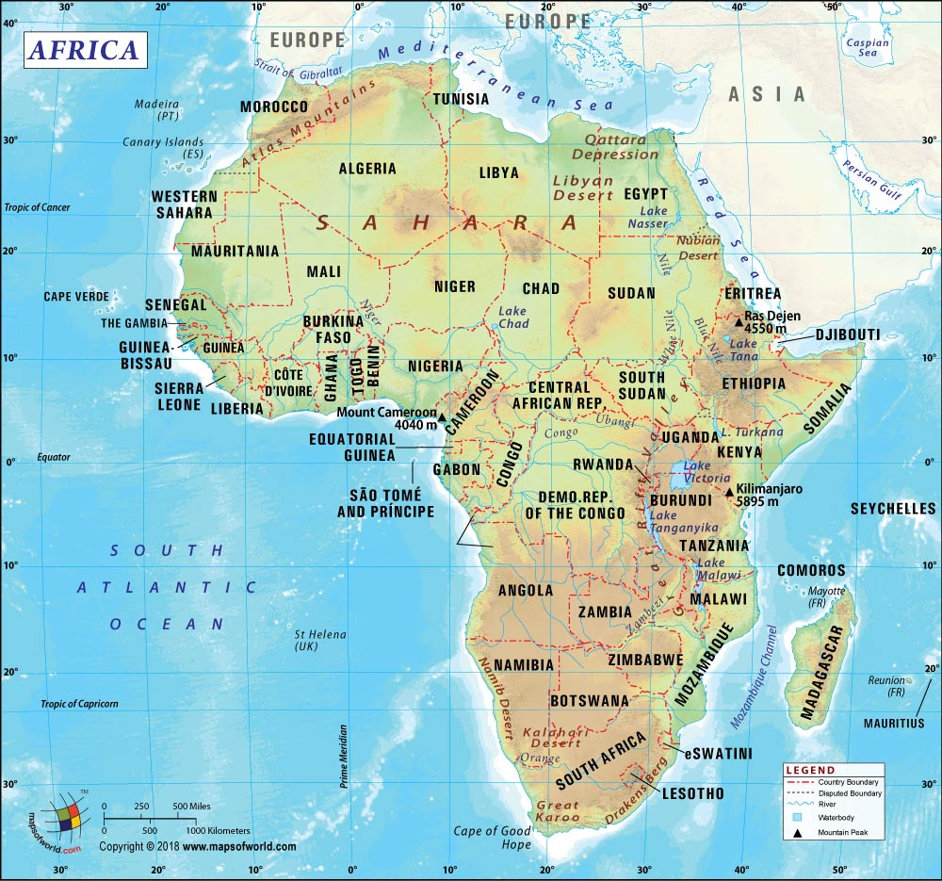

Slide 6
Mask 1

Slide 7
Mask 2
ZAIRE

Slide 8
Figure 4
ZAIRE

Slide 9
Mask 13
NIGERIA

Slide 10
Mask 14
MOZAMBIQUE

Slide 11
MASK 15 + 16
COTE D’IVOIRE
AFRICA

Slide 12
Mask 18
GABON, AFRICA
Gold coast

Slide 13
Mask 22
Cote D’Ivoire, Africa

