Slide 1
Roman Art
6 Grade Art Smart
SFX

Slide 2
Roman Art What did they make?
Roman art encompasses private art made for Roman homes as well as art in the public sphere.
The elite Roman home provided an opportunity for the owner to display his wealth, taste and education to his visitors
Sculpture
Decorative mosaics
Bronze figurines and silver bowls.
The subject matter ranged from busts of important ancestors to mythological and historical scenes, still life's, and landscapes—all to create the idea of an erudite patron steeped in culture.

Slide 3
Roman Art - Geography
Roman art is a blend of many region that became incorporated into the Roman Empire
Art from many different cultures blended together absorbed national and regional traits
Can you name the cultural influence on Roman Art?
Notes:
Can you name the cultural influence on Roman Art?
Greek
French (gaullls)
Asian
Middle easter

Slide 4
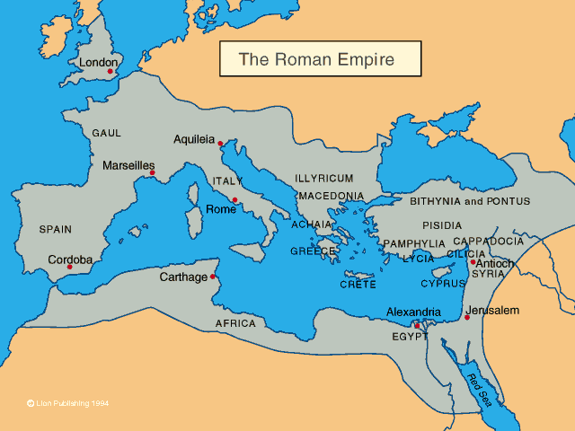

Slide 5
Regional Influences
Etruscans
Before the Roman Empire Etruscans ruled the greater part of Italy
They were major contributors to the influence on Roman Art
Portraiture
Metal work
Jewelry
Greeks
Architecture
Marble Sculpture
Mural paintings
Egypt and Syrian Coast
Glassmaking
Textiles

Slide 6
Romans
Native taste and talent for organization enabled them to develop a body of art that was uniquely Roman
Building on Greek style idealized sculpture – Realistic Portraiture
Funerary images
Records illustrious ancestry
Republican statesman
Architecture
Engineers, architects and builders constructed roads and bridges for military and expanding population
Romans invented concrete
Durable vaults
Arches spanning vast spaces
All citizens of the Roman Empire became Roman

Slide 7
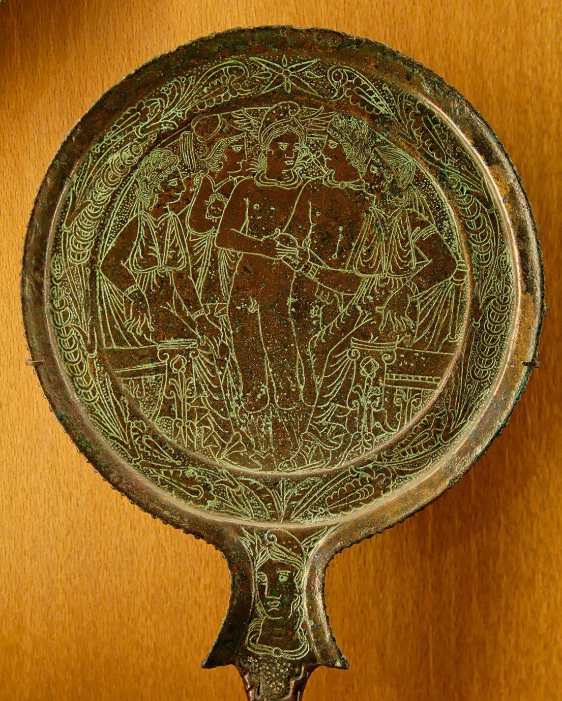
Etruscan Hand Mirror
Etruria
Created - 460/450
Bronze, poured into a disc shaped mold
Cooled decorative areas engraved into the metal
Tool: sharp engraver or chisel
Polished to a high sheen
Goddess EOS carrying her dead son Memnon
Killed during the Trojan War
Women
Etruscan woman were treated as equals,
enjoyed freedom and power

Slide 8
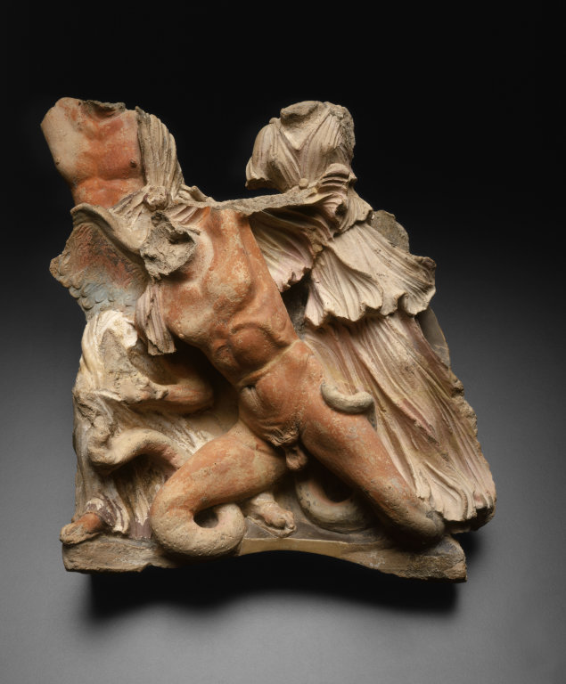
Architectural Relief Sculpture - The Gigantomachy
Struggle between and the Giants and the Olympian gods, who were led by Zeus. A god and goddess capture a Giant, depicted with wings and serpent-like features, to deliver the final blow in this epic battle.
These three animated figures were probably once part of a series of ornamental covers called antefixes, which were placed along the lowest row of roof tiles on a small building, probably a temple.
Etruscans often decorated their buildings with brightly colored sculptural compositions based on Greek mythology.
This could be a decorative part of a small temple
Colorful

Slide 9
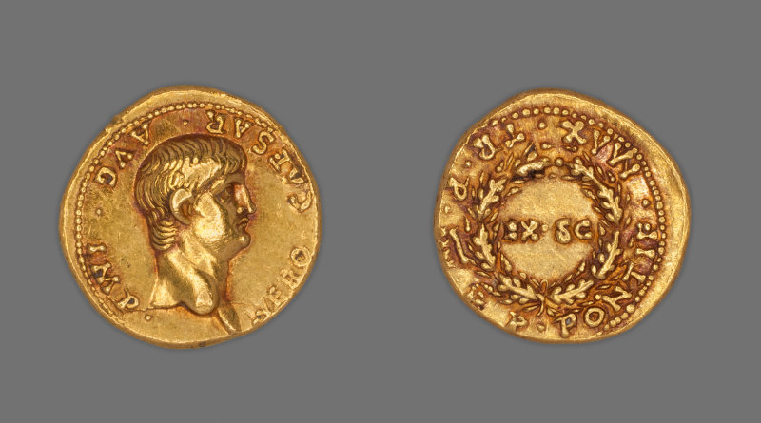
Portraits - Coins
With the establishment of the Roman Empire , there was demand for portraits of the Roman emperor and his family.
Art + Politics were connected – enhancing public images
Coins were carved into hard metal gold and forced by upper and lower dies striking
Emperor
57 or 58 AD

Slide 10
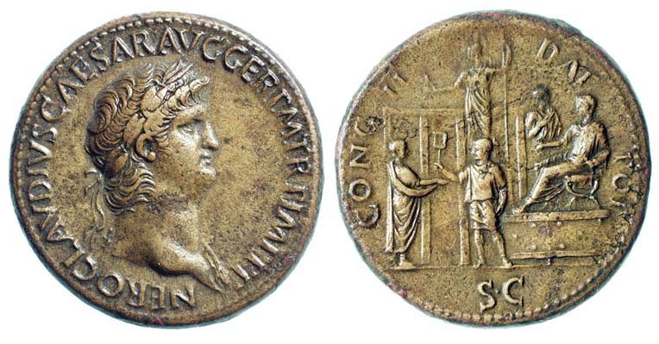
Portraits – Coins Nero 66 or 67 AD

Slide 11
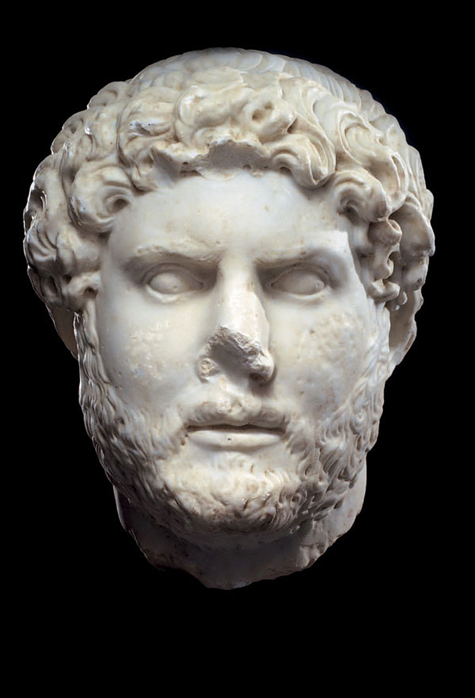
Portrait Marble Head of Emperor Hadrian
Rome, 2nd-3rd century AD
Portrait head of the Roman emperor Hadrian (117-138).
Carved in the round from fine-grained white Roman marble with finely polished surfaces.
The 33 cm. height of this piece is slightly larger than life size.
It powerfully depicts the emperor with his head turned slightly turned to the left, gaze fixed straight in front of him.
Finely engraved features.
With Hadrian begins a series of imperial Roman portraits bearded in imitation of the Greek philosophers.
A wonderful classic sculpture that communicates the dignity and authority of tis emperor who ruled at the pinnacle of the Roman empire.
Notes:
ROMAN MARBLE HEAD OF HADRIAN. Rome, 2nd-3rd century AD. Portrait head of the Roman emperor Hadrian (117-138). Carved in the round from fine-grained white Roman marble with finely polished surfaces. The 33 cm. height of this piece is slightly larger than life size. It powerfully depicts the emperor with his head turned slightly turned to the left, gaze fixed straight in front of him. His face is framed by thick curly hair and beard. The forehead is broad and smooth, the thick eyebrows are rendered with finely engraved features. The eye sockets are strongly chiaroscuro and his eyes are characterized by elongated eyelids carved in relief. The powerful wide nose increases the stern visage of the emperor. The cheekbones are high and strong, the bottoms of the ears show beneath the curly hair; the mouth is slightly open; the neck has an anatomically accurate modeling. The nose, ears and a few curls are chipped otherwise in excellent original condition. Provenance: A Florentine collection, Ex Dea Moneta. Comes with a 2009 Italian export permit.
With Hadrian begins a series of imperial Roman portraits bearded in imitation of the Greek philosophers. A wonderful classic sculpture that communicates the dignity and authority of this emperor who ruled at the pinnacle of the Roman empire.

Slide 12
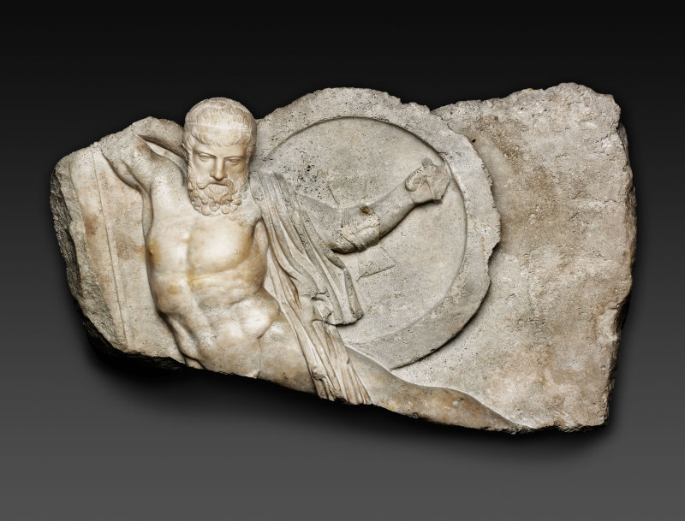
Relief of Fallen Warrior from the Shield of Athena Parthenos
Around 435 B.C., the Greek sculptor Phidias enriched the front of the shield at the side of his gold-and-ivory statue of Athena in the Parthenon with scenes of Greeks and Amazons battling in the Trojan War.
In Roman times, certain figures from this complex struggle were lifted out of their original context and enlarged to become decorative reliefs for the walls of a colonnade or courtyard.
Notes:
During the Roman era, figures were lifted out of context and enlarged as a relief panel to decorate colonades and courtyard. Dates for the 2nd century, MArble

Slide 13
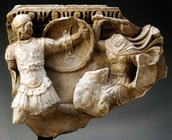
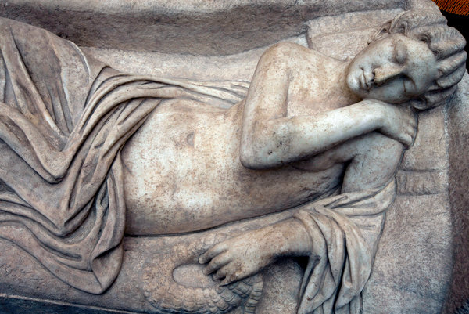
Fragment of a Sarcophagus
2nd century elaborately decorated stone coffin's call sarcophagi
Common themes
Greek mythology
battle motifs each laden with symbolism of tragedy and death

Slide 14
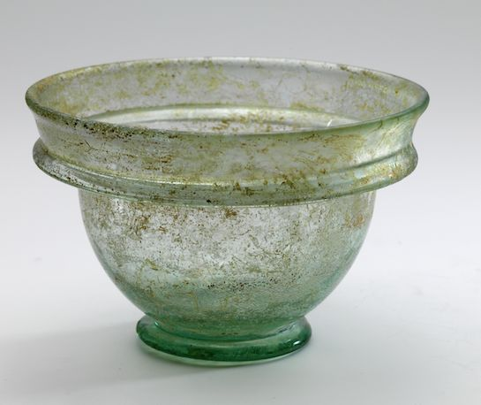
Tableware
Tableware was revolutionized by the technique of glass blowing invented in 40 BC
Once a luxury, then massed produced, treated like we treat plastic today
Found in tombs
Surface iridescence seen here is a result of their long burial. Minerals in the soil produced a remarkable finish not envisioned by the creator.

Slide 15
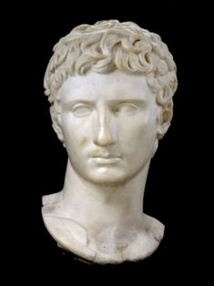
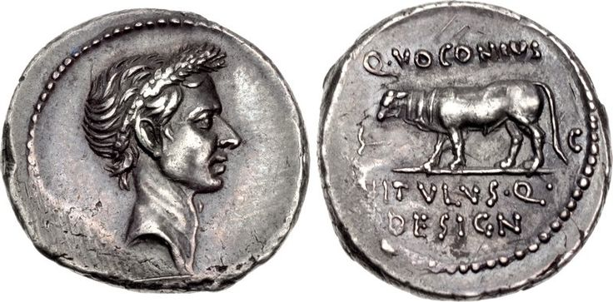
Creative Assignment Choice
Design your own coin
Portrait half art

