Slide 1
Day of the Dead
SFX Art Smart
4th Grade

Slide 2
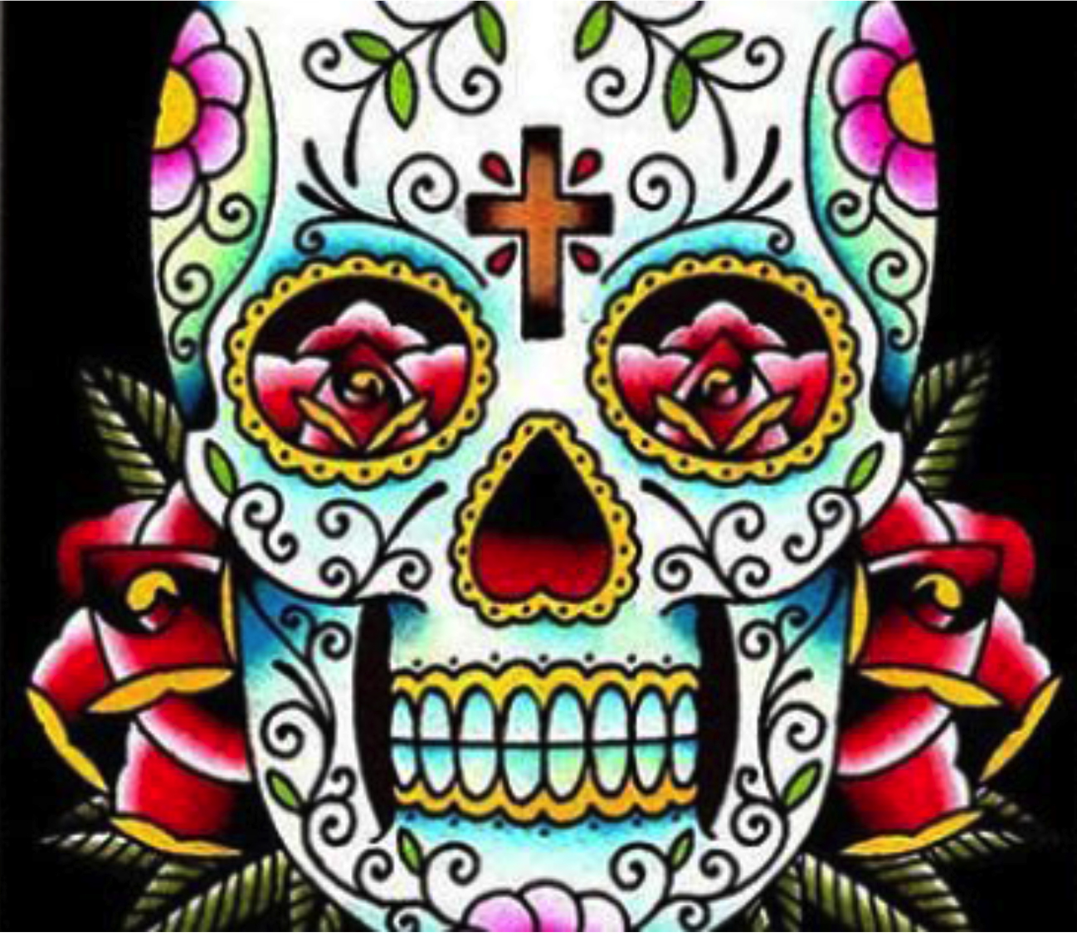
Los Dias de los Muertos, Mexican Days of the Dead
Celebrated on November 1 – All Saints Day &
November 2 – All Souls Day
It is a joyful time of remembrance, family reunion and feasting!
Relatives and friends gather together to honor their loved ones who have died.
Los Dias de los Muertos originated centuries ago in Mexico, where it is still widely celebrated to this day. The holiday is a blend of
pre-Hispanic indigenous beliefs and Spanish Catholic beliefs.
It is a celebration!
Notes:
The Days of the Dead are celebrated as a way of retaining connections with the unseen world — a world we will all return to one day.
Most people celebrate Day of the Dead out of love and commitment to their loved ones,

Slide 3
Day of the Dead
The Day of the Dead is a time of celebration and remembrance of loved ones who have passed away, much like Memorial Day in the United States.
Death is not seen as a fearful ending to life, but as a blessing. Death is less difficult then life and it is a time for joyful meetings with loved ones who have passed away.

Slide 4
Day of the Dead Beliefs
During the days of the Dead, some believe that the souls of the departed return to earth to visit with and to provide council or give advice to family and loved ones.
There is a belief that this is true every day, but that November 2nd is the day set aside to remember and honor those who have past.

Slide 5
Day of the Dead Traditions_AltArs
During the days of the dead, the family often takes the opportunity to visit the gravesite and pull weeds, clean any debris and decorate the graves of loved ones.
candles and flowers
favorite foods of the deceased are placed on the grave
family visits, eats, sings and tells favorite stories about those who have passed.
In the United States the tradition has been adapted.
Altars are usually decorated with flowers, candles, Pan de les Muertos (bread of the dead) ceramic skulls, and most importantly pictures of loved ones.
Communities often host a variety of events.
All carry the same message, celebrating the day of the dead is a true celebration of life.

Slide 6
AltArs
Food placed on the altar consists of the loved ones favorite dishes and treats.
Drinks should be placed on the altar to quench the thirst of the dead after their long journey back home
Salt is considered the spice of life and is one of the staples that are often left at the altar.
The scents of marigolds and incense are thought to be most beloved by the spirits of the dead and invite them back home.
Notes:
People stay up all night in the graveyards, socializing and telling funny stories about their dead ancestors. Musicians are hired to stroll through the graveyard, playing the favorite songs of the dead.
In the public sphere, Day of the Dead celebrations can also take the form of street parties, parades, and festivals on university campuses.

Slide 7
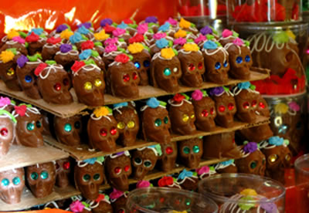
Calavera - Skulls
Sugar skulls represent a departed soul, and have their name written on the forehead. These are placed on the gravestone to honor the return of a particular spirit.
Sugar skull art reflects the folk art style of big happy smiles, colorful icing and sparkly tin and glittery adornments.
Notes:
Sugar art was brought to the New World by Italian missionaries in the 17th century. The first Church mention of sugar art was from Palermo at Easter time when little sugar lambs and angels were made to adorn the side altars in the Catholic Church

Slide 8
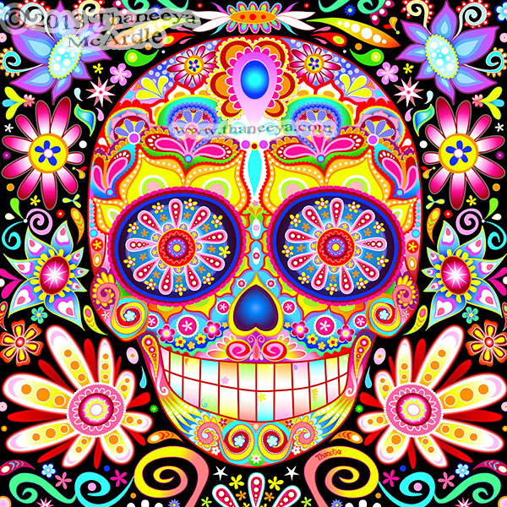
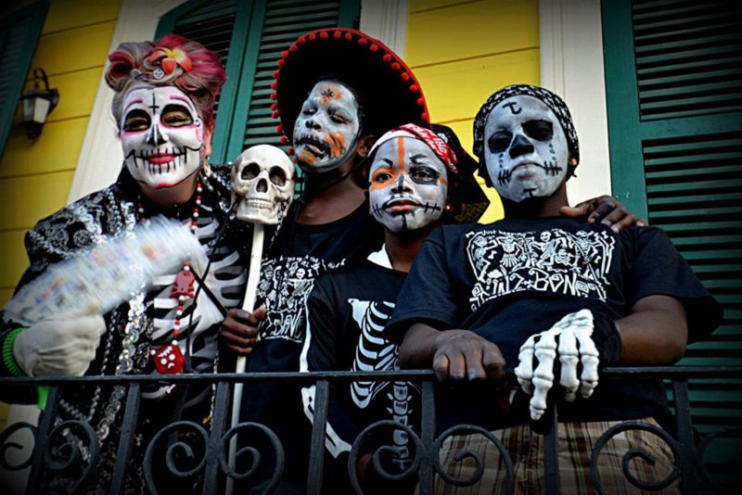
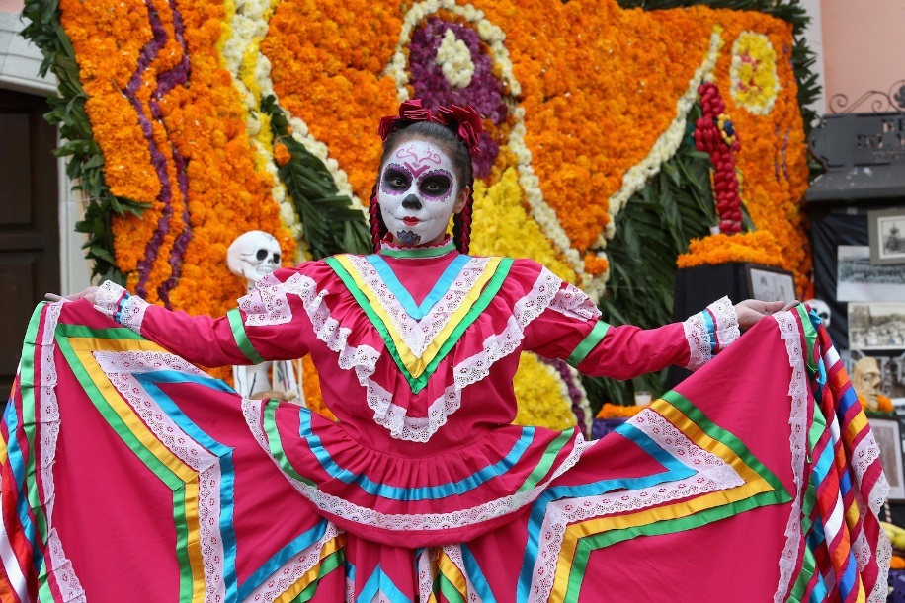
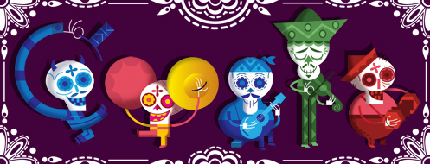
Community Celebrations & artwork
Notes:
More examples

Slide 9
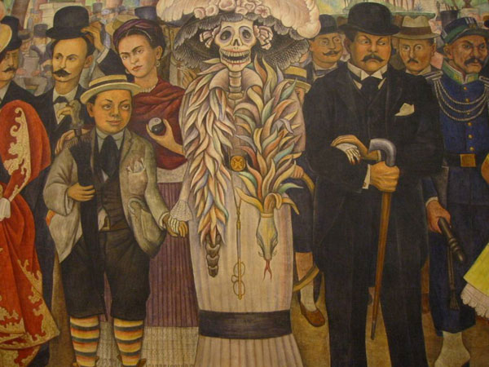
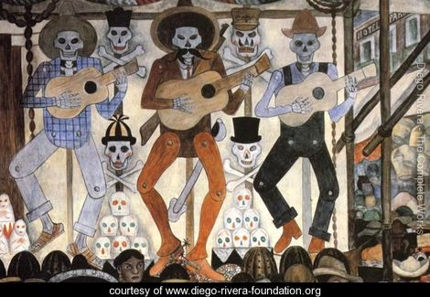
Mexican artist
Frida Khalo
Diego Rivera
Notes:
Those artist who were influenced by Day of the dead

Slide 10
Art project
Day of the dead

Slide 11
Lets Make a Calaveras (Skull) Cut Paper plates in Skull shape. Color LARGE Eyes And heart shape for nose space. Color with lots of detail and bright colors.
Notes:
http://scrumdillydo.blogspot.com/2010/10/make-paper-plate-calaveras-masks.html

